Slide 1
Vulnerability Detection in
Mobile Applications using
State Machine Modeling
Wesley van der Lee
MSc. Thesis Defence
January 16th, 2018
Delft University of Technology
Faculty EEMCS
Van der Poelzaal

Slide 2
Vulnerability Detection in
Mobile Applications using
State Machine Modeling
Wesley van der Lee
MSc. Thesis Defence
January 16th, 2018
Delft University of Technology
Faculty EEMCS
Van der Poelzaal

Slide 3


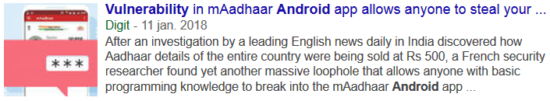
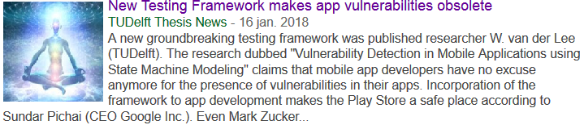

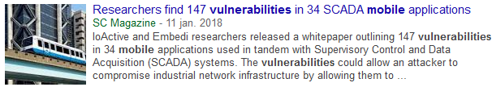

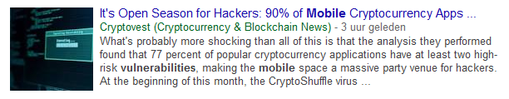
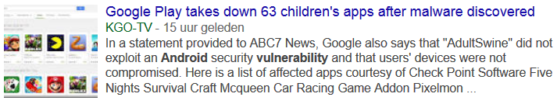
Introduction
1 / 20
1. Introduction
Notes:
https://medium.com/master-of-code-global/app-store-vs-google-play-stores-in-numbers-fd5ba020c195
Android: Google Play Store: 2.7M
Apple: App Store: 2.2M
Windows Phone Store: 300K
BlackBerry World: 130K

Slide 4
Drawbacks of Testing
2 / 20
Pre-knowledge
Completeness
No Insight
1. Introduction
Notes:
Mention state machine models.
https://medium.com/master-of-code-global/app-store-vs-google-play-stores-in-numbers-fd5ba020c195
Android: Google Play Store: 2.7M
Apple: App Store: 2.2M
Windows Phone Store: 300K
BlackBerry World: 130K

Slide 5



Research Goal
3 / 20
1. Introduction
Notes:
Current testing tools:
No insight
Not automatic enough -> Requires Manual Research
New testing technique with new insights is the area of state machine testing

Slide 6
Outline
4 / 20
State Machine Learning
Mobile State Machine Learning
Vulnerability Detection
Results
Conclusion
1. Introduction

Slide 7
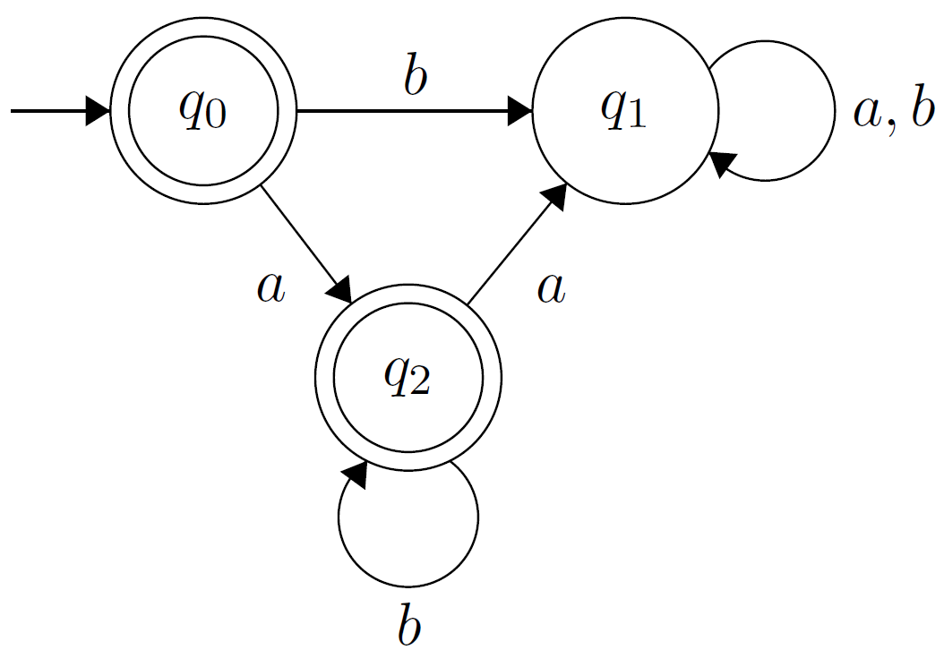



Definition of a State Machine
5 / 20
Example State Machine $A$
$States=\left\{q_{0},q_{1},q_{2}\right\}$
$Start=q_{0}$
$Transitions =$
$Alphabet=\left\{a,b\right\}$
$Accepting states=\{q_{0},q_{2}\}$
 | $$a$$ | $$b$$
$$q_{0}$$ | $$q_{2}$$ | $$q_{1}$$
$$q_{1}$$ | $$q_{1}$$ | $$q_{1}$$
$$q_{2}$$ | $$q_{1}$$ | $$q_{2}$$
2. State Machine Learning
Notes:
First, let me explain what a state machine is, before I explain how to learn one.
A state machine is an abstract model of computation that shows how a system behaves.
An example is…

Slide 8




MAT Framework
6 / 20
Minimally Adequate Teacher (Angluin, 1988)
Learner
Teacher
Membership Query(input)
simulation(input)
SUT
output
output
Yes: done
No: Counterexample
Membership Queries
Equivalence Queries
Equivalence
Query
2. State Machine Learning
Angluin, Dana. "Queries and concept learning" Machine learning 2.4 (1988): 319-342.
Notes:
The MAT framework describes a learner and a teacher
The learner’s goal is to hypothesize a conjecture state machine about a system under test, the SUT, that is accessible by the teacher.

Slide 9

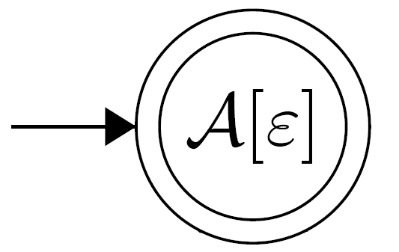
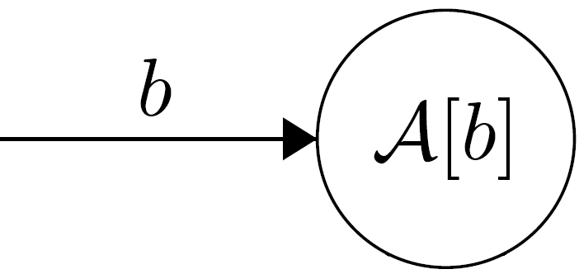
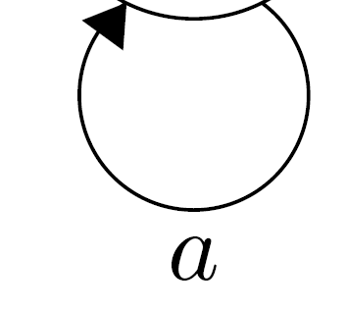
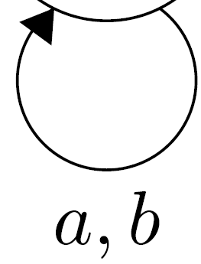
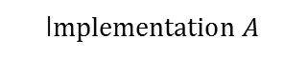




Active Learning with L*
7 / 20
Membership Query {ε,a,b}
I$mplementation A$
Output: {ε=1,a=1,b=0}
$S$ =
Prefixes (row)
$E$ =
Suffixes (column)
 | ε
ε
b
a
 | 1
 | 0
 | 1
ba | 0
bb | 0
Hypothesis $H_{1}$
Observation
Table
$$Alphabet=\left\{a,b\right\}$$
Rows:
Unique rows: identify states
2. State Machine Learning

Slide 10
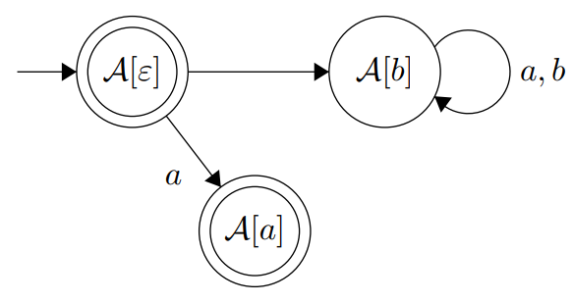
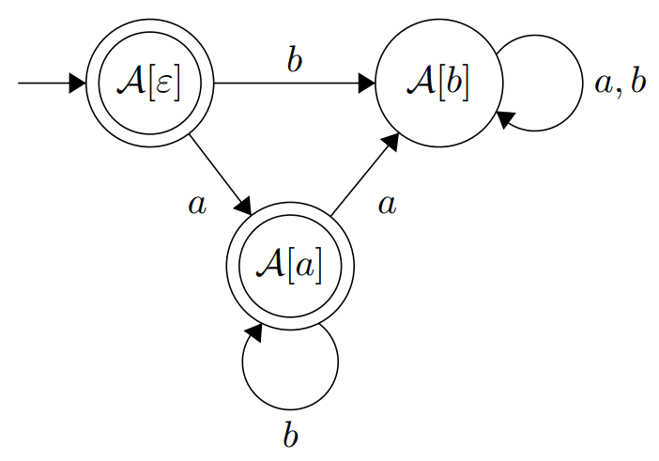



Active Learning with L*
8 / 20
YES: Equivalent!
I$mplementation A$
NO! Counterexample: ab
Equivalence Query $H_{2}$
Equivalence Query $H_{1}$
 | ε | b
ε | 1 | 0
b | 0 | 0
a | 1 | 1
ba | 0 | 0
bb | 0 | 0
aa | 0 | 0
ab | 1 | 1
Hypothesis $H_{2}$
Hypothesis $H_{2}$
Hypothesis $H_{1}$
Isberner, Malte, Falk Howar, and Bernhard Steffen. "The TTT Algorithm: A Redundancy-Free Approach to Active Automata Learning." RV. 2014.
2. State Machine Learning

Slide 11


Equivalence Queries
9 / 20
I$mplementation$
Conformance Testing
Random Walk
HappyFlow
W-Method
$P ×Σ^{n}×W$ (Chow, 1978)
$P ×Σ^{n}×W′$ (Smetsers et al., 2016)
Chow, T.S. "Testing software design modeled by finite-state machines." IEEE transactions on software engineering 3 (1978): 178-187.
Smetsers, R. et al. "Minimal separating sequences for all pairs of states." International Conference on Language and Automata Theory and Applications. Springer International Publishing, 2016.
2. State Machine Learning
Notes:
Transition cover set Access all transitions in the hypothesized model
Traversal set to access new states (if any)
Characterizing set Distinguish the output
Drawback is the test space

Slide 12





Mobile State Machine Learning
10 / 20
$$w$$
Appium command
$$w$$
command
1/0
Equivalence
OK/Error
1/0
OK/Crash
YES/Counterexample
Mapper
Appium
3. Mobile State Machine Learning
Notes:
End:

Slide 13
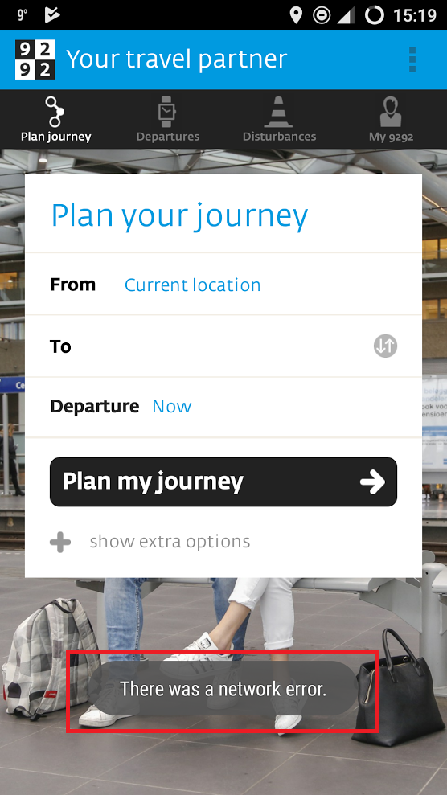

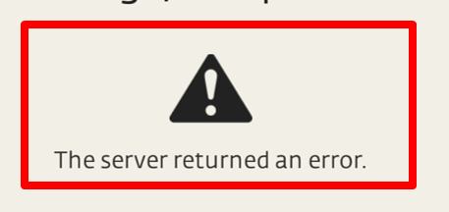
Problems when learning
11 / 20
3. Mobile State Machine Learning

Slide 14
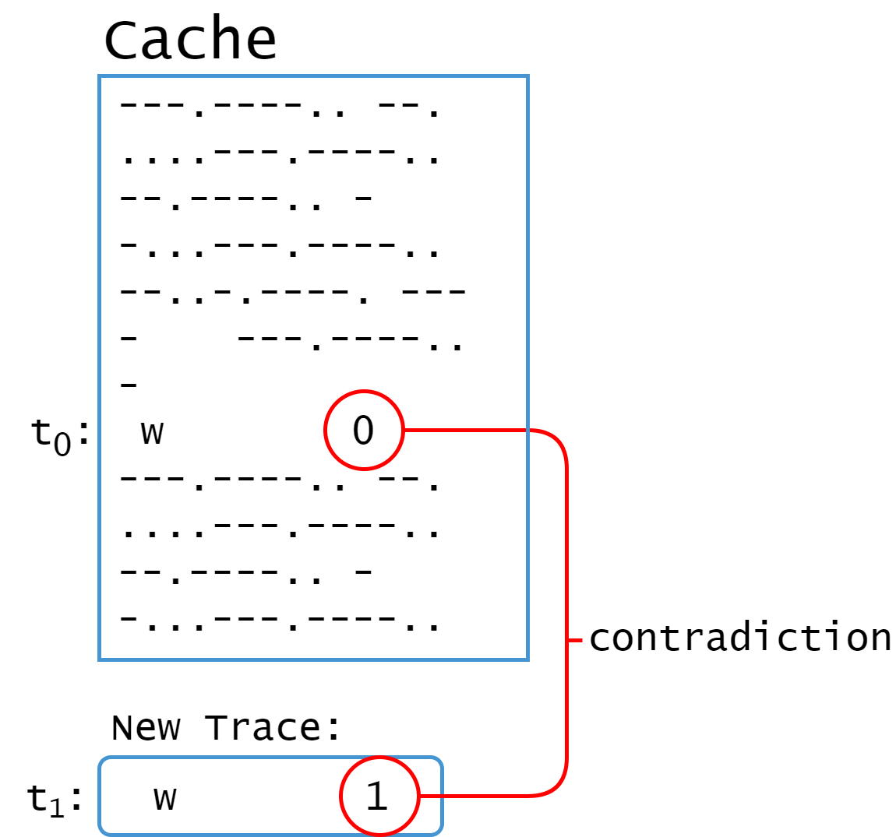
Problems when learning
12 / 20
Non-deterministic behavior
Inconsistent cache
Cache Roll-Back
3. Mobile State Machine Learning

Slide 15
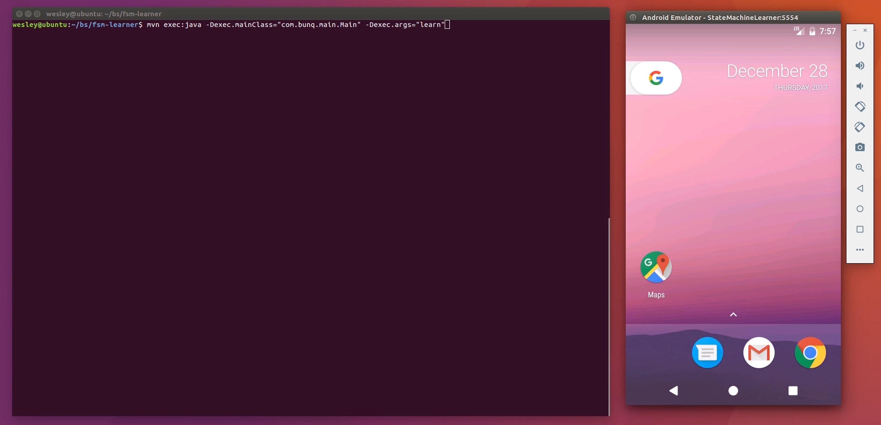
Video
13 / 20
3. Mobile State Machine Learning

Slide 16
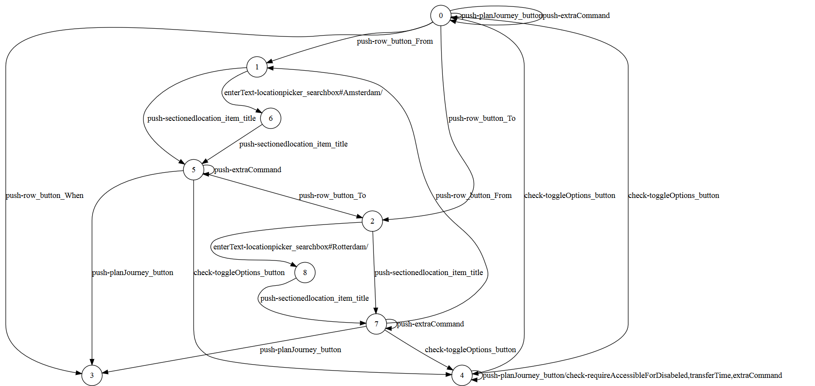
9292 Model
14 / 20
3. Mobile State Machine Learning

Slide 17
Vulnerability Detection
15 / 20
Enrich Models
Define Vulnerability Algorithms
OWASP Top10 Mobile
i.e. Insecure Authentication:
Does there exist a path to a node after the login state without traversing the login state?
4. Vulnerability Detection
Notes:
Improper Platform Usage
Insecure Communication
Insecure Authentication
Code Tampering/Extraneous Functionality

Slide 18
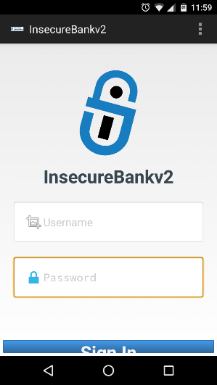
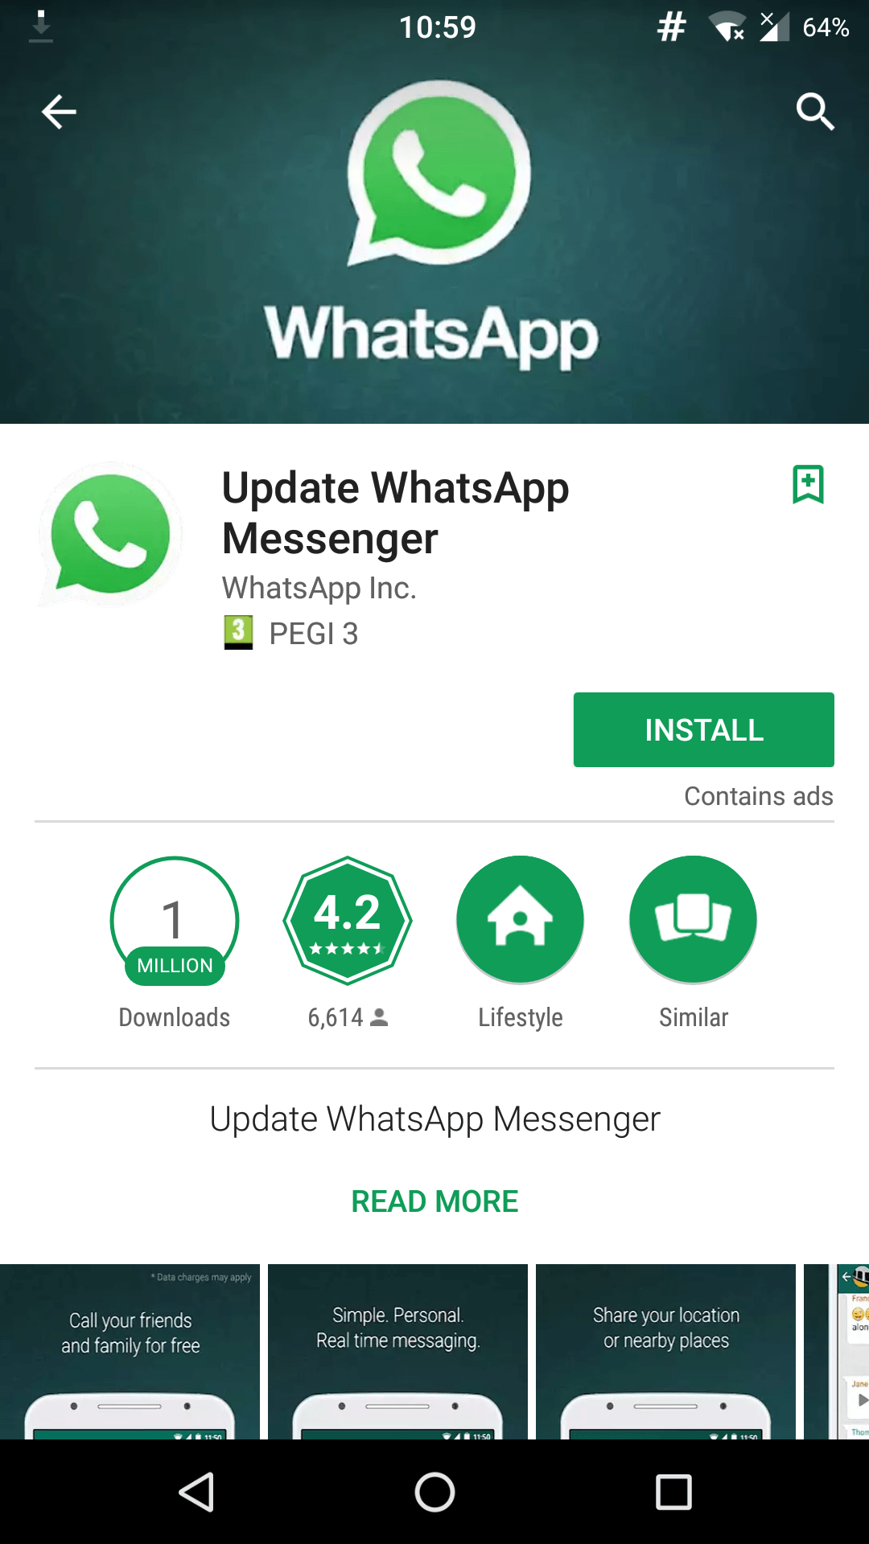
Results
16 / 20
InsecureBankV2
Known Vulnerable App
Fake WhatsApp
Adware
Malware Spreading
5. Results
Notes:
FALSE POSITIVE RATE
Improper Platform Usage
Insecure Communication
Insecure Authentication
Code Tampering/Extraneous Functionality

Slide 19
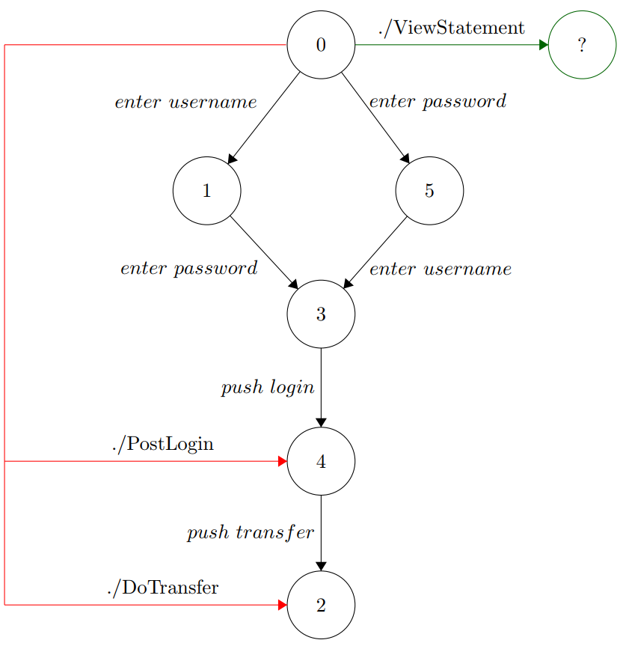
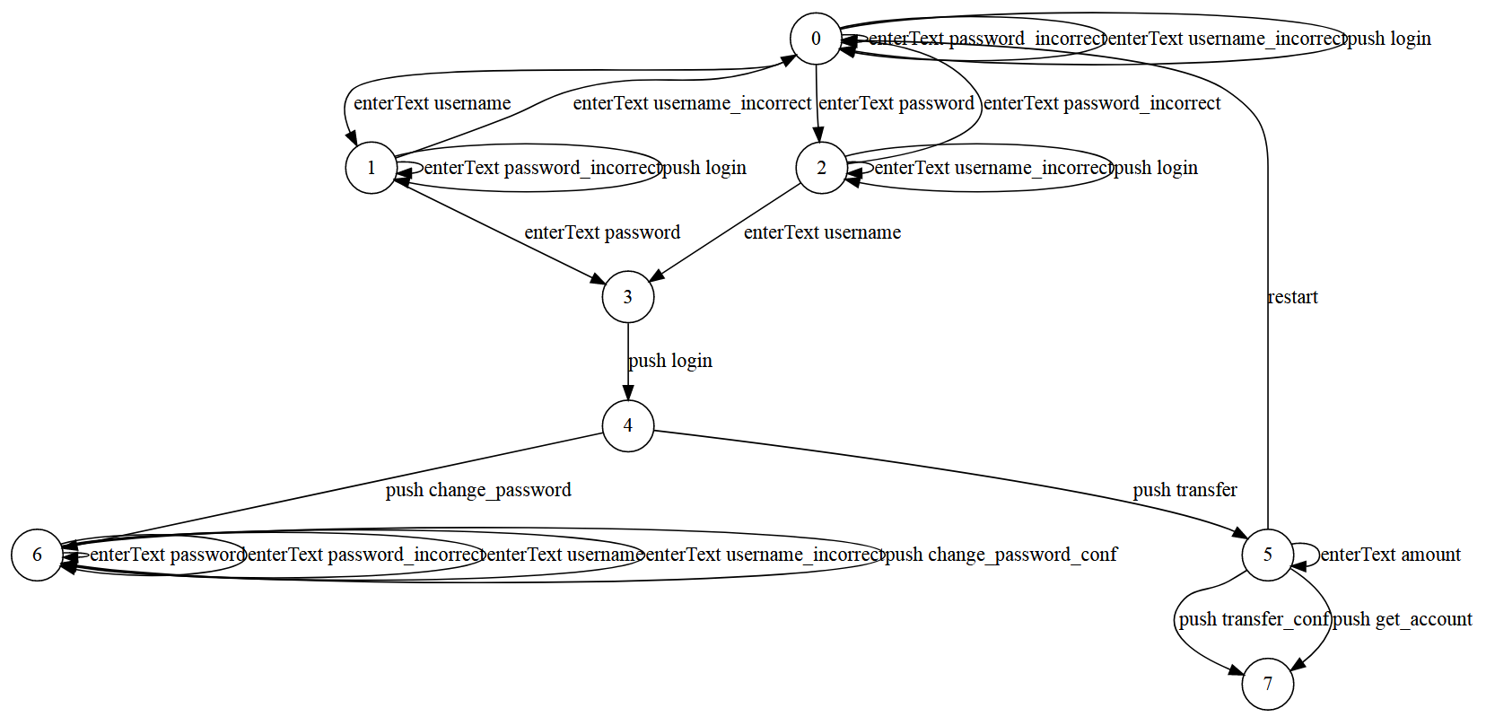
InsecureBankV2
17 / 20
Insecure Authentication
Improper Platform Usage
Insecure Communication
Login
POST http://57.97.2.11:8888/login
5. Results

Slide 20
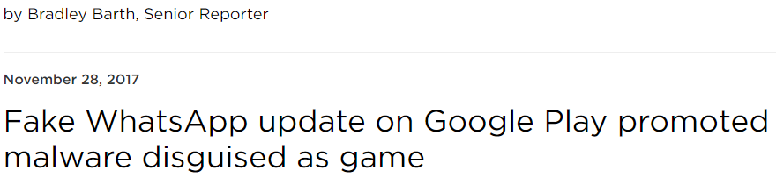
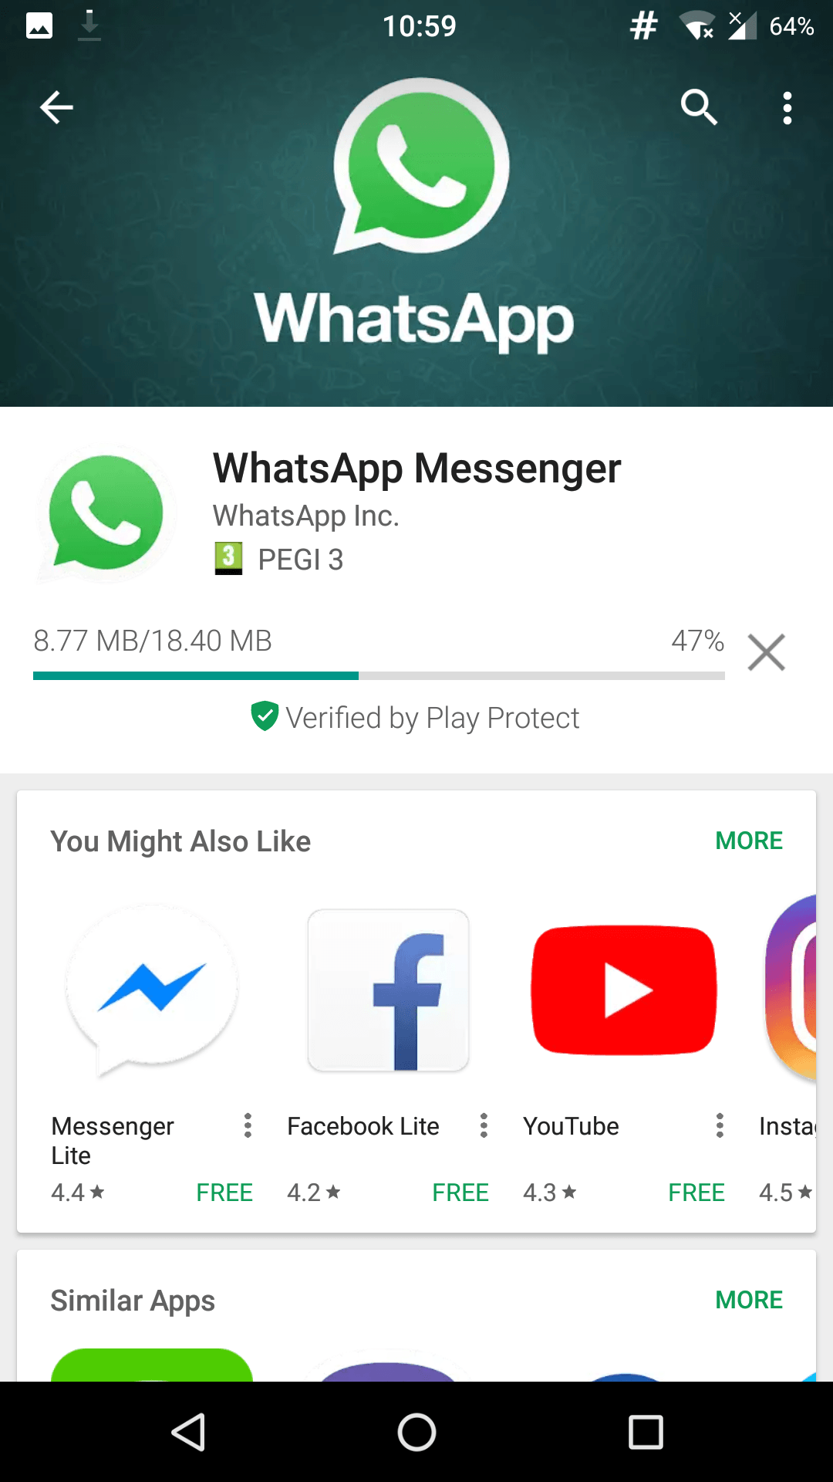
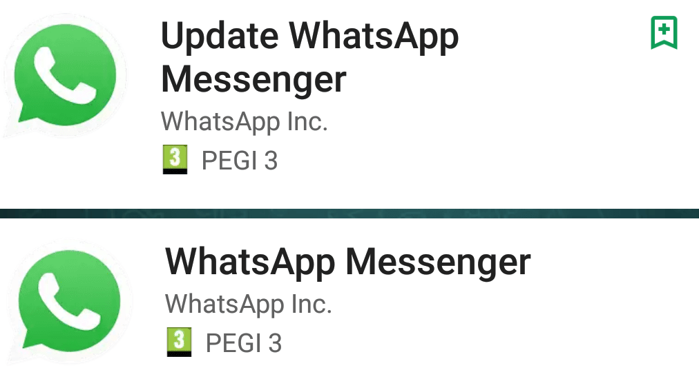
Fake WhatsApp
18 / 20
Background: Unicode trick allows malicious developers to impersonate WhatsApp developers
> 1M downloads, now deleted from Play Store
5. Results

Slide 21
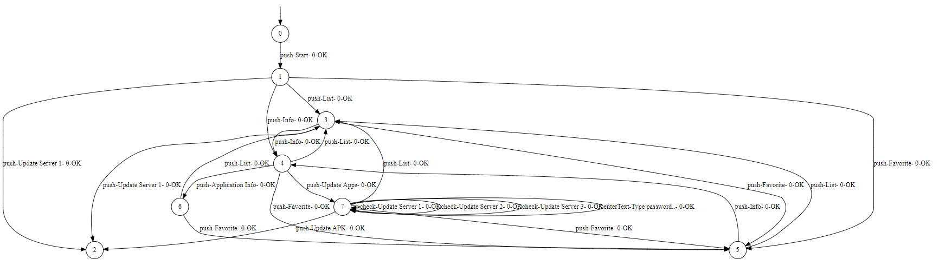
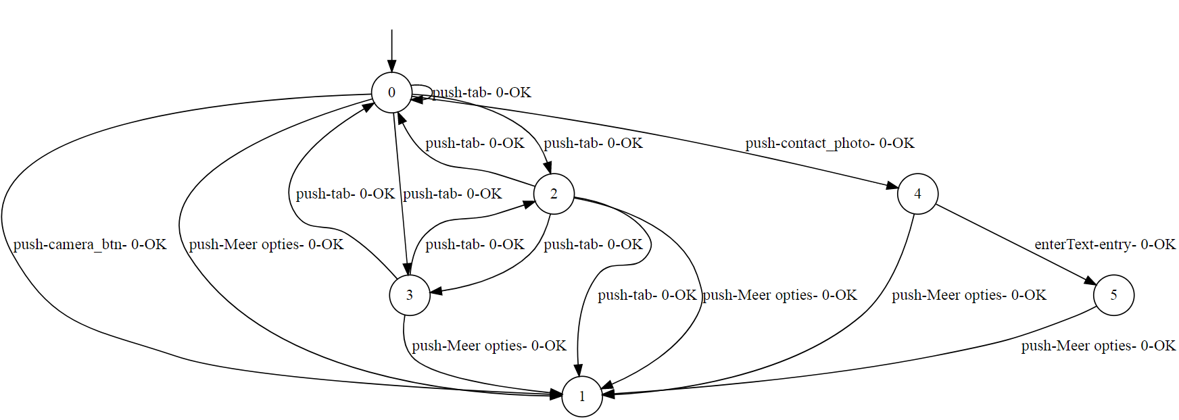
Fake WhatsApp
19 / 20
Malicious
Extraneous Functionality
SUT > REF: 100%
REF > SUT: 100%
Insecure Communication
GET http://req.startappserv
ice.com/1.4/..
Benign
5. Results

Slide 22



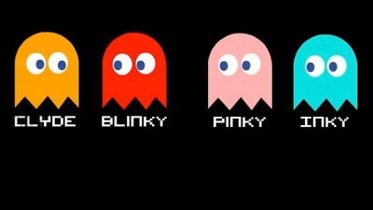
Conclusion
20 / 20
How can one identify weaknesses in mobile Android applications through feasible behavioral state machine learning?
Mapper
Appium
Contributed to the workshop on Security Protocol Implementations: Development and Analysis (SPIDA). London (United Kingdom), 23 April, 2018.
L*
TTT
RandomWalk + HappyFlow
W-Method Minimal
6. Conclusion

Slide 23

Thank You

Slide 25
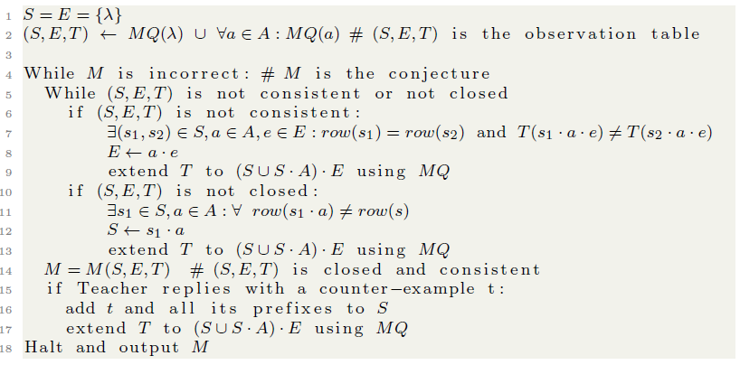

Slide 26
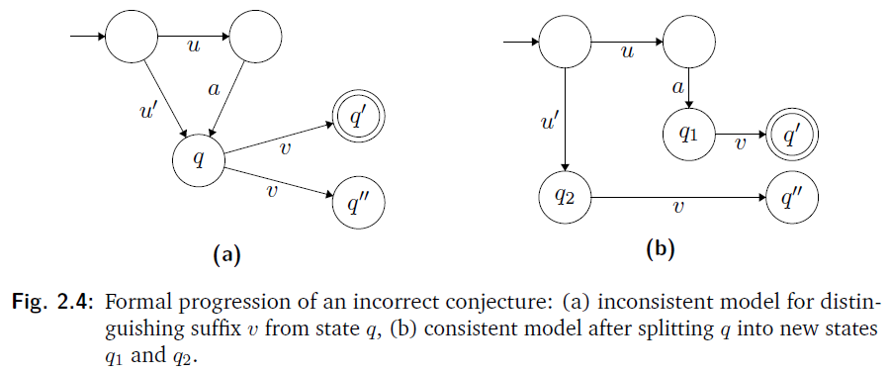

Slide 27
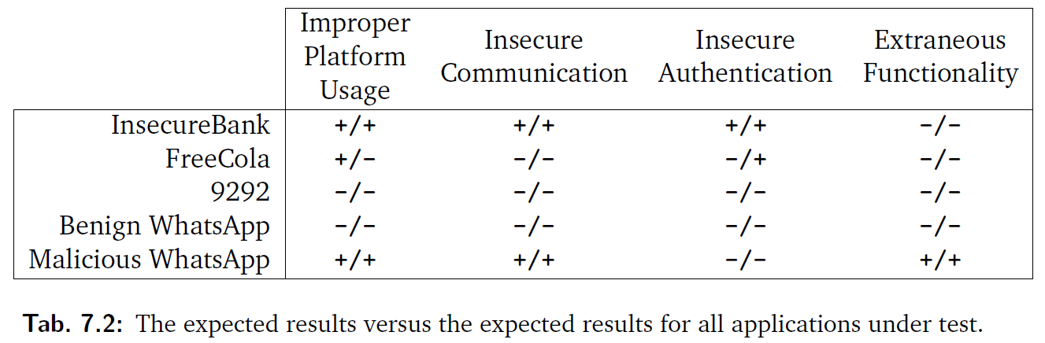

Slide 28
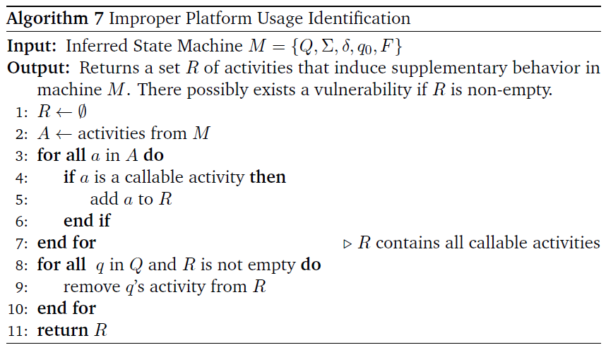
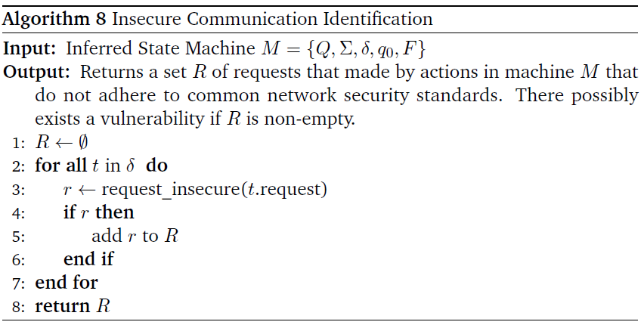

Slide 29
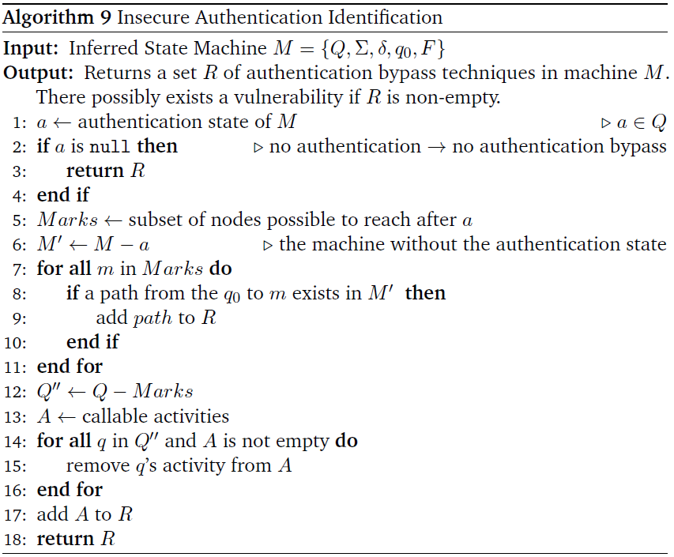
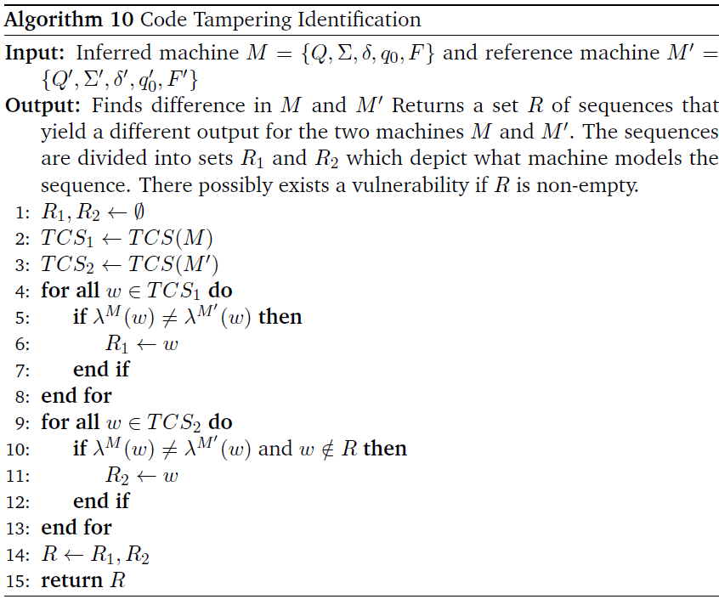

Slide 30
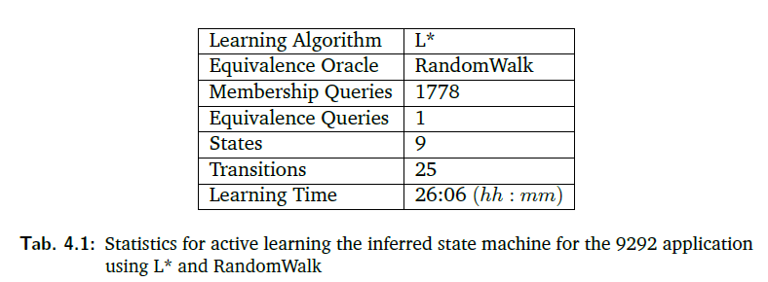
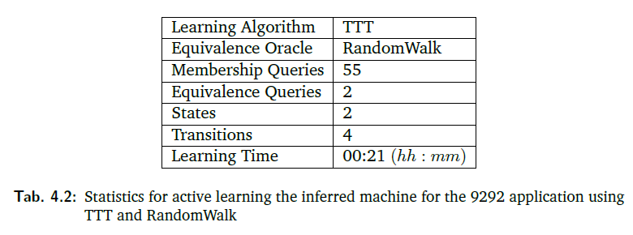
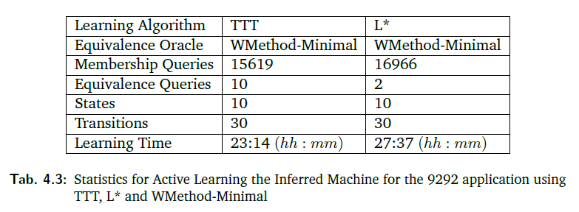

Slide 31
